Slide 1
Read-Only Memory;
Programmable Logic Array; Programmable Array Logic; Sequential Programmable Devices

Slide 2
Read‐Only Memory
A read‐only memory (ROM) is essentially a memory device in which permanent binary information is stored.
The binary information must be specified by the designer and is then embedded in the unit to form the required interconnection pattern.
Once the pattern is established, it stays within the unit even when power is turned off and on again.

Slide 3
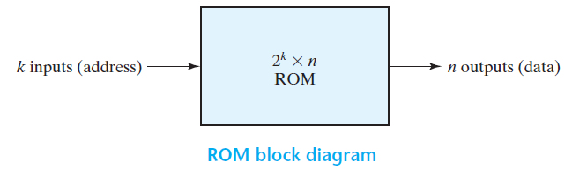
A block diagram of a ROM consisting of k inputs and n outputs is shown in Figure.
The inputs provide the address for memory, and the outputs give the data bits of the stored word that is selected by the address.

Slide 4
The number of words in a ROM is determined from the fact that k address input lines are needed to specify 2^{k} words.
Note that ROM does not have data inputs, because it does not have a write operation.
Integrated circuit ROM chips have one or more enable inputs and sometimes come with three‐state outputs to facilitate the construction of large arrays of ROM.

Slide 5
Consider, for example, a 32 × 8 ROM. The unit consists of 32 words of 8 bits each.
There are five input lines that form the binary numbers from 0 through 31 for the address.
Figure shows the internal logic construction of 32 × 8 ROM.
The five inputs are decoded into 32 distinct outputs by means of a 5 × 32 decoder. Each output of the decoder represents a memory address.
The 32 outputs of the decoder are connected to each of the eight OR gates.

Slide 6
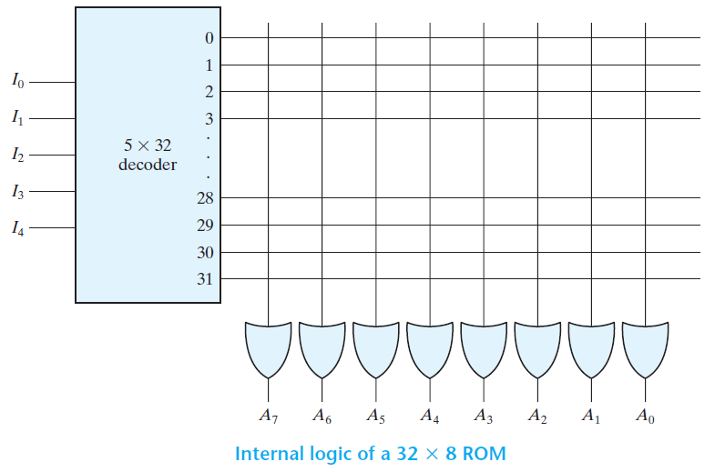

Slide 7
Since each OR gate has 32 input connections and there are 8 OR gates, the ROM contains 32 × 8 = 256 internal connections.
In general, a 2^{k} × n ROM will have an internal k × 2^{k} decoder and n OR gates. Each OR gate has 2^{k} inputs, which are connected to each of the outputs of the decoder.

Slide 8
The 256 intersections are programmable.
A programmable connection between two lines is logically equivalent to a switch that can be altered to be either closed (meaning that the two lines are connected) or open (meaning that the two lines are disconnected).
The programmable intersection between two lines is sometimes called a crosspoint.
Various physical devices are used to implement crosspoint switches.

Slide 9
One of the simplest technologies employs a fuse that normally connects the two points, but is opened or “blown” by the application of a high‐voltage pulse into the fuse.
The internal binary storage of a ROM is specified by a truth table that shows the word content in each address.
For example, the content of a 32 × 8 ROM may be specified with a truth table similar to the one shown in Table.

Slide 10
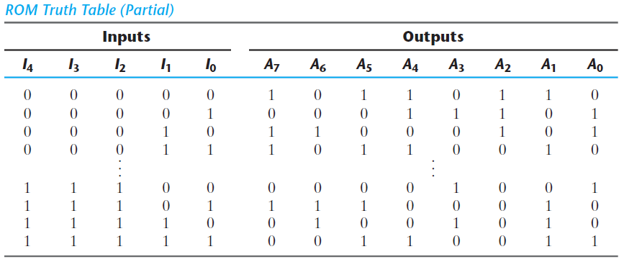

Slide 11
The hardware procedure that programs the ROM blows fuse links in accordance with a given truth table.
For example, programming the ROM according to the truth table given by Table results in the configuration shown in Figure.
Every 0 listed in the truth table specifies the absence of a connection, and every 1 listed specifies a path that is obtained by a connection.

Slide 12
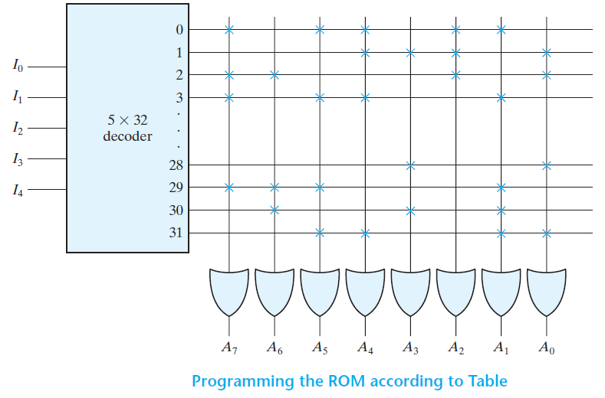

Slide 13
Combinational Circuit Implementation
The ROM is essentially a device that includes both the decoder and the OR gates within a single device to form a minterm generator.
By choosing connections for those minterms which are included in the function, the ROM outputs can be programmed to represent the Boolean functions of the output variables in a combinational circuit.

Slide 14
Example
Design a combinational circuit using a ROM. The circuit accepts a three‐bit number and outputs a binary number equal to the square of the input number.

Slide 15
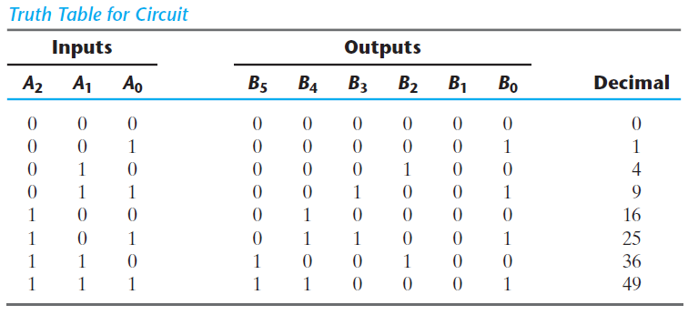
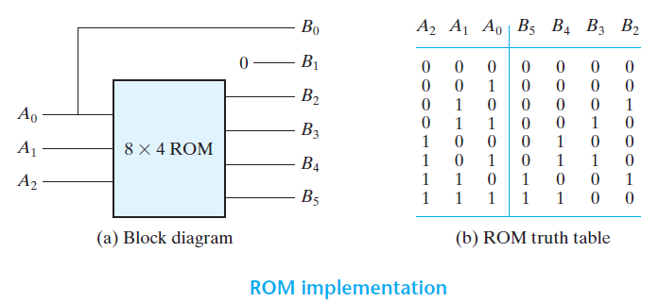

Slide 16
Problems
Implement the following Boolean function using ROM.
F₁(A, B) = ∑(1, 3)
F₂(A, B) = ∑(0, 1, 2)
F₃(A, B) = ∑(0, 3)
Design a full-adder using ROM.
Design a combinational circuit that accepts 3-input and produces its 1’s complement as output.

Slide 17
Types of ROMs
The required paths in a ROM may be programmed in four different ways.
The first is called mask programming and is done by the semiconductor company during the last fabrication process of the unit.
The procedure for fabricating a ROM requires that the customer fill out the truth table he or she wishes the ROM to satisfy.

Slide 18
The truth table may be submitted in a special form provided by the manufacturer or in a specified format on a computer output medium.
The manufacturer makes the corresponding mask for the paths to produce the 1’s and 0’s according to the customer’s truth table.
This procedure is costly because the vendor charges the customer a special fee for custom masking the particular ROM.
For this reason, mask programming is economical only if a large quantity of the same ROM configuration is to be ordered.

Slide 19
For small quantities, it is more economical to use a second type of ROM called programmable read‐only memory, or PROM.
When ordered, PROM units contain all the fuses intact, giving all 1’s in the bits of the stored words.
The fuses in the PROM are blown by the application of a high‐voltage pulse to the device through a special pin.
A blown fuse defines a binary 0 state and an intact fuse gives a binary 1 state.

Slide 20
This procedure allows the user to program the PROM in the laboratory to achieve the desired relationship between input addresses and stored words.
Special instruments called PROM programmers are available commercially to facilitate the procedure.
In any case, all procedures for programming ROMs are hardware procedures, even though the word programming is used.

Slide 21
The hardware procedure for programming ROMs or PROMs is irreversible, and once programmed, the fixed pattern is permanent and cannot be altered.
Once a bit pattern has been established, the unit must be discarded if the bit pattern is to be changed.
A third type of ROM is the erasable PROM, or EPROM, which can be restructured to the initial state even though it has bee programmed previously.

Slide 22
When the EPROM is placed under a special ultraviolet light for a given length of time, the shortwave radiation discharges the internal floating gates that serve as the programmed connections.
After erasure, the EPROM returns to its initial state and can be reprogrammed to a new set of values.

Slide 23
The fourth type of ROM is the electrically erasable PROM (EEPROM or E²PROM ).
This device is like the EPROM, except that the previously programmed connections can be erased with an electrical signal instead of ultraviolet light.
The advantage is that the device can be erased without removing it from its socket.

Slide 24
Flash memory devices are similar to EEPROMs, but have additional built‐in circuitry to selectively program and erase the device in‐circuit, without the need for a special programmer.
They have widespread application in modern technology in cell phones, digital cameras, set‐top boxes, digital TV, telecommunications, non-volatile data storage, and microcontrollers.
Their low consumption of power makes them an attractive storage medium for laptop and notebook computers.

Slide 25
Combinational PLDs
The PROM is a combinational programmable logic device (PLD) - an integrated circuit with programmable gates divided into an AND array and an OR array to provide an AND-OR sum‐of‐product implementation.
There are three major types of combinational PLDs, differing in the placement of the programmable connections in the AND-OR array.
Figure shows the configuration of the three PLDs.

Slide 26
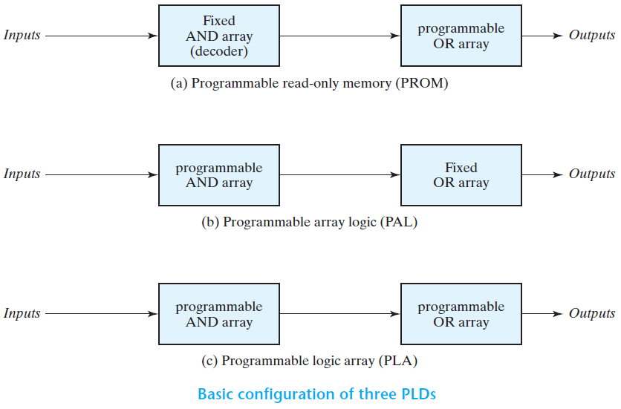

Slide 27
The PROM has a fixed AND array constructed as a decoder and a programmable OR array. The programmable OR gates implement the Boolean functions in sum‐of‐minterms form.
The PAL has a programmable AND array and a fixed OR array. The AND gates are programmed to provide the product terms for the Boolean functions, which are logically summed in each OR gate.

Slide 28
The most flexible PLD is the PLA, in which both the AND and OR arrays can be programmed. The product terms in the AND array may be shared by any OR gate to provide the required sum‐of‐products implementation.
The names PAL and PLA emerged from different vendors during the development of PLDs.

Slide 29
Programmable Logic Array
The PLA is similar in concept to the PROM, except that the PLA does not provide full decoding of the variables and does not generate all the minterms.
The decoder is replaced by an array of AND gates that can be programmed to generate any product term of the input variables.
The product terms are then connected to OR gates to provide the sum of products for the required Boolean functions.

Slide 30
The output of the OR gate goes to an XOR gate, where the other input can be programmed to receive a signal equal to either logic 1 or logic 0.
The output is inverted when the XOR input is connected to 1 (since x Ꚛ 1 = x).
The output does not change when the XOR input is connected to 0 (since x Ꚛ 0 = x).

Slide 31
Example
Implement the following two Boolean functions with a PLA:
F₁ = AB’ + AC + A’BC’
F₂ = (AC + BC)’

Slide 32
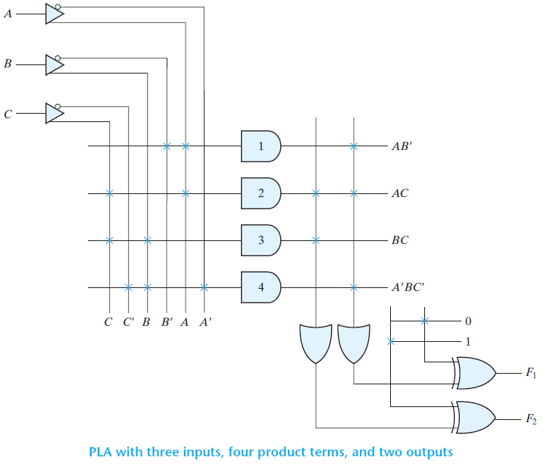

Slide 33
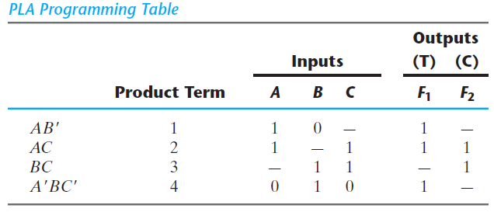

Slide 34
Example
Implement the following two Boolean functions with a PLA:
F₁(A, B, C) = ∑(0, 1, 2, 4)
F₂(A, B, C) = ∑(0, 5, 6, 7)

Slide 35
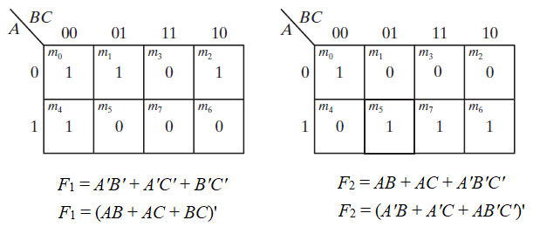
The two functions are simplified by the maps. Both the true value and the complement of the functions are simplified into sum‐of‐products form.

Slide 36
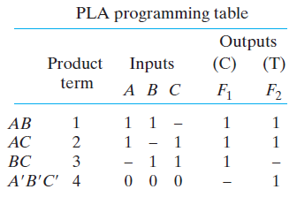
The combination that gives the minimum number of product terms is
F₁ = (AB + AC + BC)’
and
F₂ = AB + AC + A’B’C’

Slide 37
Programmable Array Logic
The PAL is a programmable logic device with a fixed OR array and a programmable AND array.
Because only the AND gates are programmable, the PAL is easier to program than, but is not as flexible as, the PLA.
A typical PAL integrated circuit may have eight inputs, eight outputs, and eight sections, each consisting of an eight‐wide AND-OR array. The output terminals are sometimes driven by three‐state buffers or inverters.

Slide 38
Example
As an example of using a PAL in the design of a combinational circuit, consider the following Boolean functions, given in sum‐of‐minterms form:
w(A, B, C, D) = ∑(2, 12, 13)
x(A, B, C, D) = ∑(7, 8, 9, 10, 11, 12, 13, 14, 15)
y(A, B, C, D) = ∑(0, 2, 3, 4, 5, 6, 7, 8, 10, 11, 15)
z(A, B, C, D) = ∑(1, 2, 8, 12, 13)

Slide 39
Simplifying the four functions to a minimum number of terms results in the following Boolean functions:
w = ABC’ + A’B’CD’
x = A + BCD
y = A’B + CD + B’D’
z = ABC’ + A’B’CD’ + AC’D’ + A’B’C’D
= w + AC’D’ + A’B’C’D

Slide 40
Note that the function for z has four product terms. The logical sum of two of these terms is equal to w. By using w, it is possible to reduce the number of terms for z from four to three.
The PAL programming table is similar to the one used for the PLA, except that only the inputs of the AND gates need to be programmed. Table lists the PAL programming table for the four Boolean functions.

Slide 41
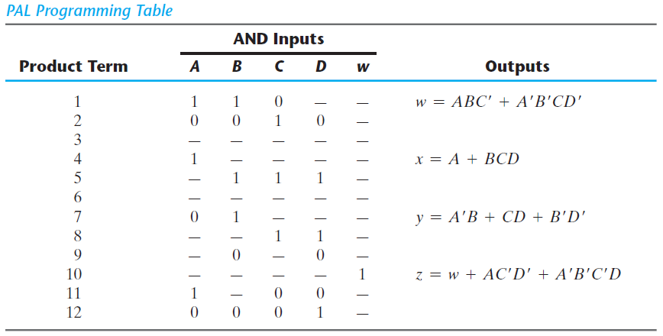

Slide 42
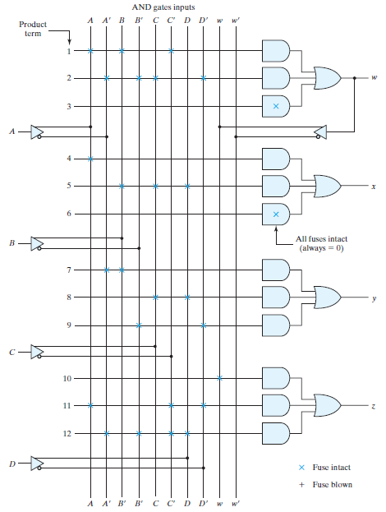
PAL with four inputs, four outputs, and a three‐wide AND–OR structure

Slide 43
Sequential Programmable Devices
The combinational PLD consists of only gates, but the sequential programmable devices include both gates and flip‐flops.
In this way, the device can be programmed to perform a variety of sequential‐circuit functions.
There are several types of sequential programmable devices available commercially, and each device has vendor‐specific variants within each type.

Slide 44
The three major types sequential programmable devices are
Sequential (or simple) Programmable Logic Device (SPLD)
Complex Programmable Logic Device (CPLD)
Field‐Programmable Gate Array (FPGA)

Slide 45
Sequential Programmable Logic Device (SPLD)
The sequential PLD is sometimes referred to as a simple PLD to differentiate it from the complex PLD.
The SPLD includes flip‐flops, in addition to the AND-OR array, within the integrated circuit chip.
The result is a sequential circuit as shown in Figure.
A PAL or PLA is modified by including a number of flip‐flops connected to form a register.

Slide 46
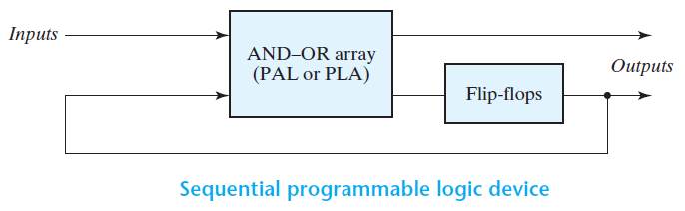
The circuit outputs can be taken from the OR gates or from the outputs of the flip‐flops.
Additional programmable connections are available to include the flip‐flop outputs in the product terms formed with the AND array.
The flip‐flops may be of the D or the JK type.

Slide 47
Complex Programmable Logic Device (CPLD)
The design of a digital system using PLDs often requires the connection of several devices to produce the complete specification.
For this type of application, it is more economical to use a complex programmable logic device (CPLD), which is a collection of individual PLDs on a single integrated circuit.
A programmable interconnection structure allows the PLDs to be connected to each other in the same way that can be done with individual PLDs.

Slide 48
Figure shows the general configuration of a CPLD.
The device consists of multiple PLDs interconnected through a programmable switch matrix.
The input-output (I/O) blocks provide the connections to the IC pins. Each I/O pin is driven by a three state buffer and can be programmed to act as input or output.

Slide 49
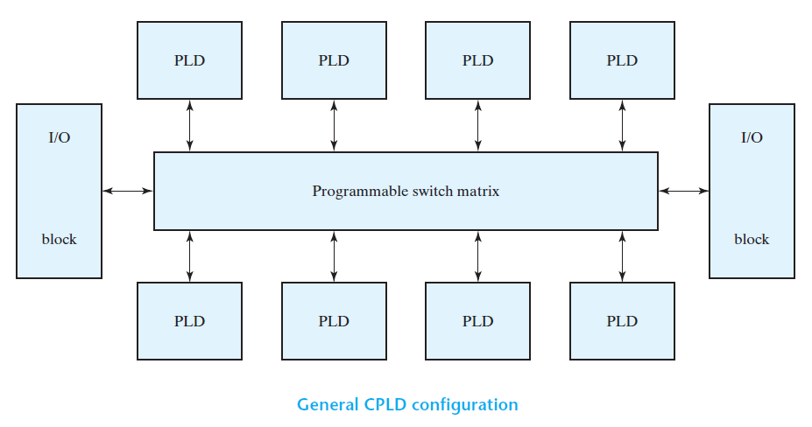

Slide 50
The switch matrix receives inputs from the I/O block and directs them to the individual macrocells. Similarly, selected outputs from macrocells are sent to the outputs as needed.
Each PLD typically contains from 8 to 16 macrocells, usually fully connected. If a macrocell has unused product terms, they can be used by other nearby macrocells.
In some cases the macrocell flip‐flop is programmed to act as a D, JK, or T flip‐flop.

Slide 51
Field‐Programmable Gate Array (FPGA)
A field‐programmable gate array (FPGA) is a VLSI circuit that can be programmed at the user’s location.
A typical FPGA consists of an array of millions of logic blocks, surrounded by programmable input and output blocks and connected together via programmable interconnections.
There is a wide variety of internal configurations within this group of devices.

Slide 52
The performance of each type of device depends on the circuit contained in its logic blocks and the efficiency of its programmed interconnections.
A typical FPGA logic block consists of lookup tables, multiplexers, gates, and flip‐flops.
A lookup table is a truth table stored in an SRAM and provides the combinational circuit functions for the logic block.

Slide 53
The design with PLD, CPLD, or FPGA requires extensive computer‐aided design (CAD) tools to facilitate the synthesis procedure.
Among the tools that are available are schematic entry packages and hardware description languages (HDLs), such as ABEL, VHDL, and Verilog. Synthesis tools are available that allocate, configure, and connect logic blocks to match a high‐level design description written in HDL.

